Slide 1
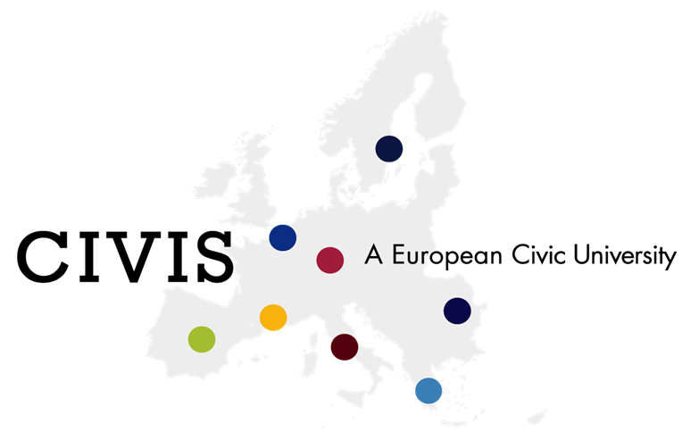

Slide 2
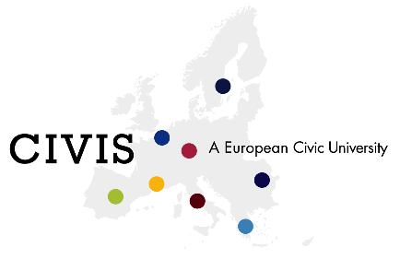
European Universities: Ambition
ORIGIN:
President Macron discourse in 2017
Preparation of the 2021-2027 European Commission program
Pilot initiative launched in October 2018
AMBITION:
“Promoting common European values and a strengthened European identity by bringing together a new generation of Europeans, who are able to cooperate and work within different European and global cultures, in different languages, and across borders, sectors and academic disciplines.
Reaching a substantial leap in quality, performance, attractiveness and international competitiveness of European higher education institutions and contributing to the European knowledge economy, employment, culture and welfare by making best use of innovative pedagogies and striving to make the knowledge triangle a reality. ‘European Universities’ will be key drivers to boost the quality of higher education”

Slide 3
European Universities: Call for proposal
“unparalleled initiative which requires a quantum leap in cooperation between all types of higher education institutions from all regions in Europe and at all levels of the organisation, across all areas of activity, from teaching and learning to research and innovation”
  EXPECTATIONS IN THE LONG-RUN (2025):
  A shared and long-term strategy on education, research, and innovation
  European inter-university campuses
  Going beyond existing higher education cooperation models
  Social inclusiveness & geographical balance
  Preparing new generations to future changes
  Links to territories as tools for openess to the entire society

Slide 4
European Universities: Results
54 applications (+300 universities involved)
17 alliances selected in June 2019
5M€ / Alliance -> overall EU budget : 85M€
3 yrs pilot projects

Slide 5
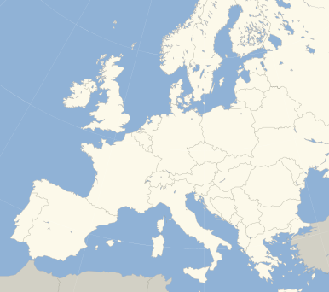

CIVIS: our European University Alliance
Aix Marseille Université (France),
National and Kapodistrian University of Athens (Greece),
University of Bucharest (Romania),
Université Libre de Bruxelles (Belgium),
Universidad Autonoma de Madrid (Spain),
Sapienza Università di Roma (Italia),
Stockholms Universitet (Sweden),
Eberhard Karls Universität Tübingen (Germany).

Slide 6
CIVIS, a European Civic University
384 000 students and 55 000 staff, 7 languages plus English as lingua franca.
Our vision
A challenge-based approach and impact-driven alliance making the best use of the knowledge triangle and partnerships
Reinforced impact from the local to the global scales, contributing to social, cultural and economic dynamism
Our strategy
Pool and share our respective strengths within the entire alliance
  Digital Campus, Workshops, ...
Develop collaboration at all scales of our universities (education, research, but also administrative procedures, etc) and push for multilateral cooperation
  Call for projects, Admin Staff Task Forces, ...
A joint governance involving all 8 university stakeholders (students, professors, staff), leading to the creation of a legal entity of its own
  Board of Rectors, Participative Council, ...

Slide 7
Hubs on Global Challenges
Education Research Innovation @ the European Level
Health
Cities, Territories , Mobility
Digital & Technological Transformations
Society, Culture, Heritage
Climate Environment Energy
our digital campus: a platform to connect all stakeholders from local to global levels
Local OPEN LABS
Relationships with Regions,
civil society, public & private sectors
-> civic engagement for students, contribution to regional development…
Environnement climat énergie
International strategy: Relationships with
Mediterranean & African Partners

Slide 8
Global challenges will help structuring our European University
Expertise
Practice
Research facility
Private groups
Incubator
Fab Lab
Traineeship offices
HUB
Interdisciplinary research
PhD/research
Masters
Bachelor
European programs through 8 universities pathways
Financing
Executive Education
Euro-Med summerschool
Local authorities
Field action w/ local community
Board: Profs, students, Staffs + other stakeholders: Private groups, local authorities, …

Slide 9
European Hubs on global challenges
HUB
Interdisciplinary research
PhD/research
Masters
Bachelor
European programs through 8 universities pathways
Field actions, Executive education,
Innovation/ transfer (incubator…), etc.
Activities undertaken with external stakeholders
International Strategy partnerships with the Mediterranean area & Africa
Board
(Universities’ representatives + external stakeholders)

Slide 10
CIVIS Mobility Objectives
Objectives :
Enable seamless and multi-dimensional mobility models that will enable 10% student mobility by 2022 (12.000)
Achieve 50% student mobility within the Alliance by 2025
Proposals :
Short term mobility funded by the project (summerschools, etc)
University-wide Erasmus exchange agreements between each of the eight member universities
Erasmus Without Paper and European Student Card to be implemented -> CIVIS student card (solution: card via app/internet)
Going beyond specific actions to increase mobility
Specific actions to increase mobility include:
- Inclusion of compulsory mobility in programmes at BA and MA levels
- Providing automatic recognition of credits for student mobility projects
- Developing courses in English
- etc.
Numbers (3yrs):
Long term mobility between CIVIS member universities: 1,500 students (BA, MA and PhD)
1,200 short mobilities either ‘stand-alone’ or blended (funded by the project)
Innovative virtual mobility for all: 120 virtual mobility courses, for 10 000 students

Slide 11
Challenges for CIVIS teaching programs
Reach 50% mobility by 2025
Design European interdisciplinary pathways related to the 5 Global challenges between the 8 universities: identify niches, champions,…
Importance of :
  knowledge triangle (training-research-innovation)
  Transversal skills
  multilingualism
  Openness to the external World (employability, contribution to Regions’ development strategies, civic and service learning activities..)
  Recognition of credits

Slide 12
How to make CIVIS a reality?
Mainstreaming student mobility within CIVIS:
Learn to know the other 7 partners in your field and beyond
Promote student mobility
Identify academic pathways (recognition of credits)
Identify internal locks + strategy dvpt
Getting advantage of CIVIS calls:
Open Labs: develop activities with/for CIVIS students on the territory involving other stakeholders
Hubs: participate to CIVIS workshops on the global challenges to develop interdisciplinary knowledge triangle projects with colleagues from other universities
Innovative pedagogies: participate to CIVIS online courses development, to Multilinguism strategy, research and tools development, etc
WITH CIVIS PARTNERS:
Discuss possibilities for joint degrees, diplomas & flexible pathways
Share new and innovative initiatives
Share Multidisciplinarity models
Nominate CIVIS referents in each sector
Involve faculties, departments, labs in multidisciplinary & Knowledge triangle projects

Slide 13
Thank You

